Slide 1

What is the Labour Market?
The Labour Market is simply the local job market! What kind of jobs are around you? What big companies are there? Are there any growing industries and are jobs well paid?
What is Labour Market Information?
Labour Market Information helps to break down the ‘world of work’- ranging from descriptions of different careers, their entry routes, promotional prospects, salaries paid, skills and qualifications needed, etc
Labour Market Information also covers future demand- what kinds of jobs will be in demand after leaving school and what kinds of skills will be needed.

Slide 2
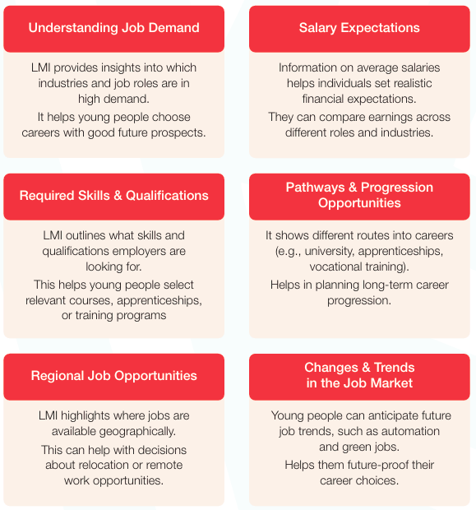
What’s the point – why do we learn about Labour Market Information?
Here’s how Labour Market Information can help you:

Slide 3
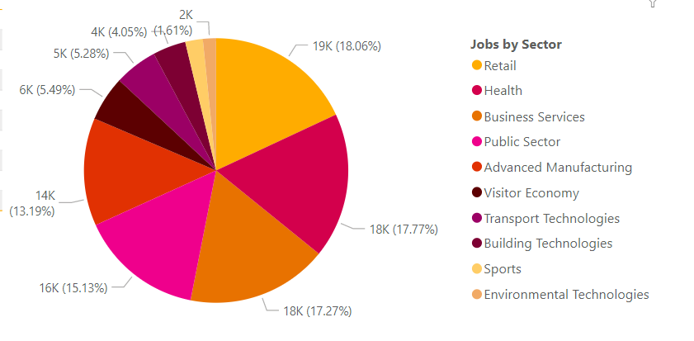
LMI For The Black Country

Slide 4
Sector Trends in Health
Global Trends
More focus on mental health and emotional wellbeing
Encouraging wearable devices or wellness apps
Diet trends moving towards personalised and plant-based options
More awareness of how screen time affects wellbeing
Types of Jobs Available
Care Worker
Nurse
Healthcare Assistants
Physiotherapist
Paramedic
Mental Health Support Worker
Youth Worker
Wellbeing Coach
Personal Trainer
Subjects/Skills to Consider
Biology
Psychology
PE
Health and Social Care
PSHCE
Maths
English
Empathy & Compassion
Health & Safety Awareness
Confidentiality
Resilience
Teamwork

Slide 5
Companies in Wolverhampton: Health
The Royal Wolverhampton NHS Trust
Bhandal Dental Practice
WV Active
Nuffield Health
Compton Care Group Limited
Ingeus UK Limited

Slide 6
Sector Trends in Advanced Manufacturing
Global Trends
More teamwork needed between people and machines
Refined use of AI and automation
Digitisation of industrial sectors (manufacturing, transport, etc.)
Electrification (of cars, aircraft, rail)
Types of Jobs Available
Machine Operator
Assembly Technician
Quality Control Assistant
Engineering Apprentice
Robotics Technician
Product Designer
Data Analyst
Health & Safety Officer
Operations Manager
Subjects/Skills to Consider
Maths
Physics
DT
ICT/Computing
English
Attention to detail
Teamwork
Adaptability
Digital & IT Skills
Problem-Solving

Slide 7
Companies in Wolverhampton: Advanced Manufacturing
Jaguar Land Rover
Assa Abloy Limited
Collins Aerospace
Moog Aircraft Group
Tarmac Building Products Limited
Steelway

Slide 8
Sector Trends in Construction
Global Trends
Massive pressure to reduce carbon emissions
Push for green materials, energy-efficient buildings, etc.
Adoption of AI, drones, 3D printing, etc. to improve efficiency and safety.
Types of Jobs Available
Project Manager
Civil Engineer
Architect
Quantity Surveyor
Wood Trades
Electrical Trades
Technical and IT roles
Landscape Architect
Subjects/Skills to Consider
Maths
Physics
DT
ICT/Computing
English
Willingness to Learn
Time Management
Practical Skills
Digital Skills

Slide 9
Companies in Wolverhampton: Construction
William Gough & Sons Limited
Taylor Woodrow Construction
Speller Metcalfe Limited
United Living Group Limited
Wates Group Limited
McAuliffe Group Ltd
Carver (Wolverhampton) Limited

Slide 10
Sector Trends in Retail
Global Trends
Massive increase in online shopping, AI and automation
Interactivity in stores; mixture of online and in-person experiences
Focus on being eco-friendly and ethical practices
Types of Jobs Available
Sales Assistant
Cashier
Customer Service Advisor
Stockroom Assistant
Online Retail Assistant
Logistics & Supply Chain
Warehouse Operative
Delivery Driver
Subjects/Skills to Consider
English
Maths
Business
ICT/Computing
DT
Languages
Economics
Customer Service
Digital Skills
Communication
Numeracy
Organisation

Slide 11
Companies in Wolverhampton: Retail
JD Sports Fashion
SportsDirect.com Retail Limited
H&M Hennes & Mauritz UK Limited
Boots UK Limited
Primark Stores Limited
Matalan Retail Ltd.
B & M Retail Limited
Poundland Limited
Tesco PLC
J Sainsbury PLC

Slide 12
Sector Trends in Business Services
Global Trends
Marketing, staffing and IT sectors are using increased AI and automation
Strong focus on sustainability
Companies being bought/merged
Investors most interested in smart tech solutions
Subscription services becoming much more common.
Types of Jobs Available
Project Manager
Accountant
Mortgage Advisor
Cyber Security Specialist
Other administrative occupations
Subjects/Skills to Consider
Business
Economics
Maths
ICT/Computing
English
Numeracy
Customer Service
Organisation
Adaptability

Slide 13
Companies in Wolverhampton: Business Services
Charter Court Financial Services Group PLC
LSP Holding (UK) Ltd
Mehta Holdings Limited
King & Moffatt UK Limited
Exact Mortgage Experts Limited
Kirstall Limited
Core Five Consulting Limited
Overwerx Ltd
LGPS Central Limited
Technology Management Limited
S & B Industrial Investments Limited

Slide 14
Sector Trends in Visitor Economy
Global Trends
Changes in travel trends
Increase in ‘wellness tourism’ (yoga retreats, nature walks, etc.)
Focus on eco-friendly travel
Attractions being more hands-on and interactive; utilisation of technology
Types of Jobs Available
Hotel Receptionist
Waiter
Travel Agent Assistant
Tour Guide
Airport Customer Service
Event Assistant
Ticketing/Front of House Staff
Sports/Leisure Centre Assistant
Venue Staff
Social Media Coordinator
Subjects/Skills to Consider
English
Geography
Business
ICT/Computing
Languages
Drama/Performing Arts
Maths
Hospitality & Catering
Travel & Tourism
Presentation Skills
Cultural Awareness
Customer Service
Digital Skills

Slide 15
Companies in Wolverhampton: Visitor Economy
Wolverhampton Grand Theatre (1982) Limited
Wolverhampton Art Gallery
University of Wolverhampton at The Halls
Wolverhampton Racecourse
Wolverhampton Wanderers Football Club Bars & Restaurants
Hotels
Retail & Shopping

Slide 16
Sector Trends in Public Sector
Global Trends
Governments using more digital tools, AI and automation
Focus on employee wellbeing
NHS and central governments growing in jobs, local councils are struggling
Modernisation of workplaces
Better opportunities for professional development
Types of Jobs Available
Support Worker
Customer Service Advisor
Business Support Assistant
Community Engagement Worker
Recycling and Waste Services Operator
Healthcare Assistant
Teaching Assistant
Admin Support
Youth Worker
Subjects/Skills to Consider
English
Maths
Social Sciences (Geography, Sociology, Psychology, etc.)
ICT/Computing
Business
Languages
Politics
History
Health & Social Care
Citizenship
Adaptability
Willingness to Learn

Slide 17
Companies in Wolverhampton: Public Sector
City of Wolverhampton Council
University of Wolverhampton
City of Wolverhampton College
The Royal Wolverhampton NHS Trust
Emergency Services (UK)
Ministry of Housing, Communities and Local Government (MHCLG)

Slide 18

Task
Complete the worksheet provided on Teams and answer the following questions using the previous slides:
- List examples of jobs that you can do in this sector (minimum of 5)
- What skills and qualities do you need to work in this sector?
How can you start a career in this sector? You may research online to help you.
Please complete and submit using the assignment tab on the Year 12 / Year 13 Teams group

Slide 19

Useful Links for More Information…
WORKBOX – Workbox
Careermap Careerometer – Careerometer | Careermap
National Careers Service – Careers advice - job profiles, information and resources | National Careers Service
Prospects – Prospects | Job & Course Search | Career & University Advice
icould – icould - Career ideas and information for your future
CareerPilot – Careerpilot : Plan your future work & study
Youth Employment UK – Youth Employment UK | Home
Shaping Futures – Labour Market Information - Shaping Futures

