Slide 1






CRE8TIVE RESOURCES
Secondary
Exploring LMI - Wolverhampton
LEARNING OUTCOMES
Knowledge, Skills
& Actions
To know industries local to Wolverhampton
To be able to name several key local employers
To understand which skills are in demand
3 Minutes
Think of a job which begins with every letter in the word W-O-L-V-E-R-H-A-M-P-T-O-N. No repeats!
Are there lots of opportunities in Wolverhampton for different types of employment?
NEW VOCABULARY
WIN, Local Offer, Marston’s, Jaguar Land Rover, Finance, construction
Notes:
TEACHER NOTES & IDEAS
Remind students of the learning journey (What theme you are doing – Possibly recap what they can remember from last lesson)
ATTRIBUTION AND COPYRIGHT
–Icons and logos for Cre8tive Resources are created by Michael Gillman and are subject to copyright ©
- All graphics and images are sourced correctly through the following sites:
Premium licence at https://www.freepik.com/
www.Pixabay.com
https://www.pixelscrapper.com/help
- Factual information is not copyrighted.
- Where information has been taken from reliable 3rd party websites – it is done so for analytical purposes in small pieces of text and for educational purposes.
DISCLAIMER
- Always check the content of any lesson and videos linked before teaching to ensure suitability for your classroom and your school
Responsibility for checking material for suitability for students must be done by the classroom teacher. This includes ensuring everything is appropriate including the external video links that have been provided.
The PowerPoint material is fully editable and we encourage teachers to remove, change or edit anything they wish.
Video links are working at time of creation of this lesson. Please bear in mind YouTube content owners can withdraw their content at any time and responsibility lies with the classroom teacher to ensure the content is updated and new video links are found.
Cre8tive Resources does not charge or provide a subscription update service for this lesson the responsibility for updating lesson content lies with the classroom teacher.
Further Terms and Condition regarding Copyright and our terms of use can be found on our website here https://cre8tiveresources.com/terms-of-use/

Slide 2

What is the Labour Market?
The Labour Market is simply the local job market! What kind of jobs are around you? What big companies are there? Are there any growing industries and are jobs well paid?
What is Labour Market Information?
Labour Market Information helps to break down the ‘world of work’- ranging from descriptions of different careers, their entry routes, promotional prospects, salaries paid, skills and qualifications needed, etc
Labour Market Information also covers future demand- what kinds of jobs will be in demand after leaving school and what kinds of skills will be needed.

Slide 3
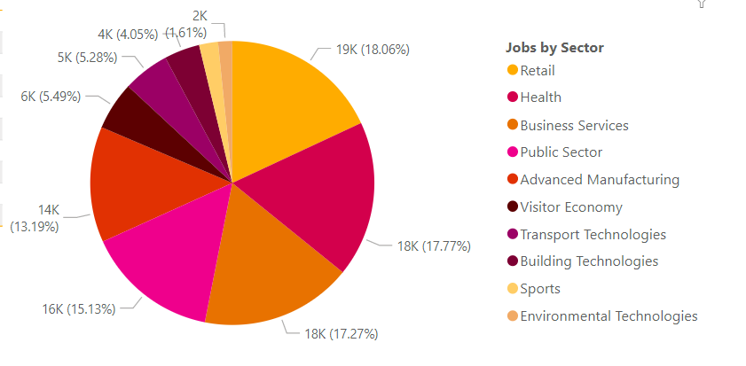
LMI For The Black Country

Slide 4


Video Slide - Wolverhampton University
Wolverhampton University
What can I do there?
4 Minutes
Task
How diverse is Wolverhampton University?
What is your first impression of the campus and city?
What is the closest big city you can get to in 20 minutes by train?
Which cultural attractions are mentioned?
What do you think is the aim of this video? Do you think it has achieved it? If so, how?
Notes:
TEACHER NOTES & IDEAS
URL: https://www.youtube.com/watch?v=czJc5w6NSD8
4 minute video from University of Wolverhampton
Answers on next slide

Slide 5

Video Slide - Answers
How diverse is Wolverhampton University? Students from over 130 countries attend
What is your first impression of the campus and city? Share your opinion with a partner
What is the closest big city you can get to in 20 minutes by train? Birmingham
Which cultural attractions are mentioned? Wolverhampton Art Gallery, Grand Theatre, The Halls
What do you think is the aim of this video? Do you think it has achieved it? If so, how? Share your thoughts with your table
Answers
Click to reveal
Answers
Click to reveal
Answers
Click to reveal
Extension
Why do you think universities produce videos like this one?
Notes:
TEACHER NOTES & IDEAS

Slide 6


Case Study 1: Marston’s
A company which has run pubs and brewed beer for nearly 2 centuries, Marston’s boasts a workforce of 14,000 employees with many more including partners.
Jobs include; being a pub tenant, running a brewery, distributing the product and promoting the range of services and beverages to establishments across the UK.
The Carlsberg Marston’s Brewing Company’s Head Office is on Brewery Road in Wolverhampton. They started in 1875, floated on the stock market in 1947 and became the world’s third largest brewer in 2005.
New projects include fibre bottles and electric delivery vehicles as part of their sustainability promises.
Task
What are the benefits to the city of Wolverhampton of having a long-standing business based there?
Notes:
TEACHER NOTES & IDEAS
Taken from: https://yourfutureblackcountry.com/ and https://www.marstonspubs.co.uk/ and https://www.carlsbergmarstons.co.uk/about-us/our-history/the-story-of-marston-s-beer-company/ for analytical and educational purposes to demonstrate local LMI

Slide 7

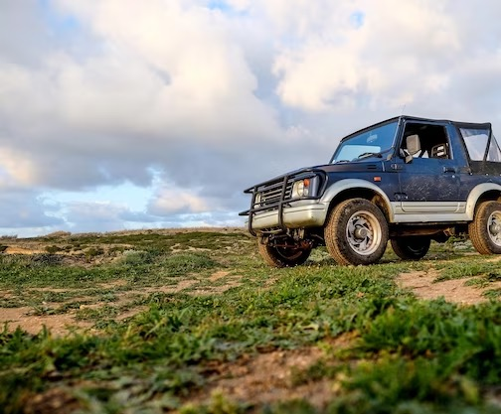
Case Study 2: Jaguar and Land Rover
Jaguar Land Rover (JLR) have an engineer manufacturing plant based in Wolverhampton, as well as dealerships. 30,000 people work for the company in the UK.
In recent news, the company have announced that the Wolverhampton site will be renamed the Electric Propulsion Manufacturing Centre, as part of a £15 billion investment to become the world’s leading producer of luxury modern cars. The 120 acre site, with its roof of solar panels, will make 1200 engines a day.
Hundreds of new jobs will be created in West Midlands as part of this investment, including technicians, test engineers and plant operatives.
Task
Extension
Which other jobs can you think of which are needed to run such a large manufacturing warehouse?
Do you agree with how the company describes itself? Why or why not?
In a building with solar panels, which other measures could there be on a net zero site?
Notes:
TEACHER NOTES & IDEAS
Taken from: https://yourfutureblackcountry.com/ and https://media.jaguarlandrover.com/news/2023/04/jlr-invest-ps15-billion-over-next-five-years-its-modern-luxury-electric-first-future and https://www.bbc.co.uk/news/uk-england-coventry-warwickshire-66514581 and https://www.autocar.co.uk/opinion/industry/jaguar-land-rover-behind-doors-its-wolverhampton-engine-plant for analytical and educational purposes to demonstrate local LMI

Slide 8
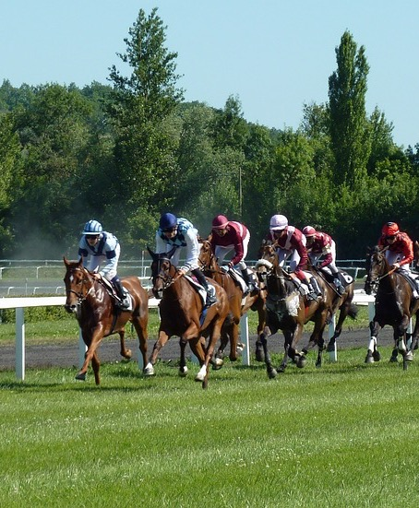
Case Study 3: Wolverhampton Racecourse
Wolverhampton Races is one of Britain’s busiest racecourses, hosting 80 horse racing fixtures across the year, as well as several music events and offers venue hire. Recent events include; local business awards, rugby matches and a family drone light show.
Located close to Wolverhampton City Centre and 15 miles away from Birmingham, the racecourse has its own Holiday Inn Hotel, parking for around 2000 vehicles and a helipad.
With lots of training available, the company like to see people progress, offering financial support towards accredited qualifications and paid time off to take exams. HR and Accountancy are two main area where people can train and gain new skills and qualifications.
Some of the roles in a racecourse include: Heads Groundsman, Casual Hospitality Staff, Bar People, Chef, Night Supervisor, Sales, Security and Project Managers.
The racecourse is owned by a national group called Arena Racing Company (ARC) which has horse racing venues across the country.
Task
What is most appealing about this company for:
Prospective employees?
Tourists?
Investors?
Notes:
TEACHER NOTES & IDEAS
Taken from: https://yourfutureblackcountry.com/ and https://careers.arenaracingcompany.co.uk/job-search/ and https://www.linkedin.com/company/wolverhampton-racecourse-and-conference-centre/about/ for analytical and educational purposes to demonstrate local LMI

Slide 9

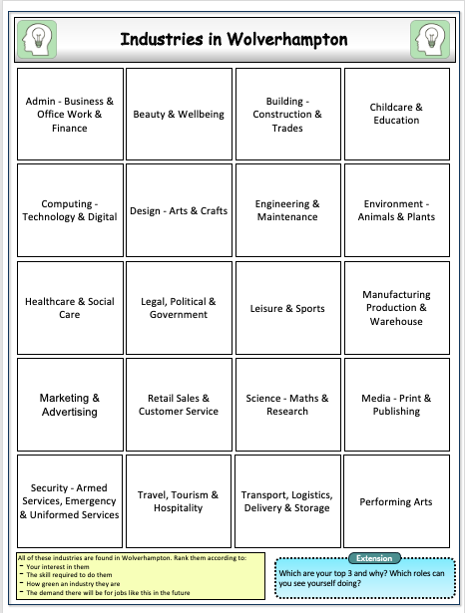
Task
Take your card sort of the main industries in Wolverhampton. With a partner, rank them according to:
Your interest in them
The skill required to do them
How green an industry they are
The demand there will be for jobs like this in the future
Extension
Which sector do you think contributes most to the local economy? Why?
Notes:
TEACHER NOTES & IDEAS
Please see separate worksheet for handout
Taken from: https://yourfutureblackcountry.com/sectors/

Slide 10

Skills Needed in Wolverhampton
The average grade achieved at A-Level in the city of Wolverhampton is C+, the national average is B. Young people need more support to continue and stick to higher studies.
To stay competitive, technical skills at Level 3+ (A Levels) are in great demand. These will be needed in growth areas of AI, automation and software engineering.
Higher qualified people who can navigate the connection between digital skills and the environment. This is with the growth in smart energy and the devices in this area.
Task
If improved, which area above will have the most impact on the local city of Wolverhampton? How?
Extension
What are the wider benefits of working towards the above skills gaps?
Notes:
TEACHER NOTES & IDEAS
Taken from page 15: https://consultation.wolverhampton.gov.uk/cwc/education-skills-and-employment-strategy/user_uploads/strategy-document-draft-education-skills-and-employment-2023.pdf

Slide 11
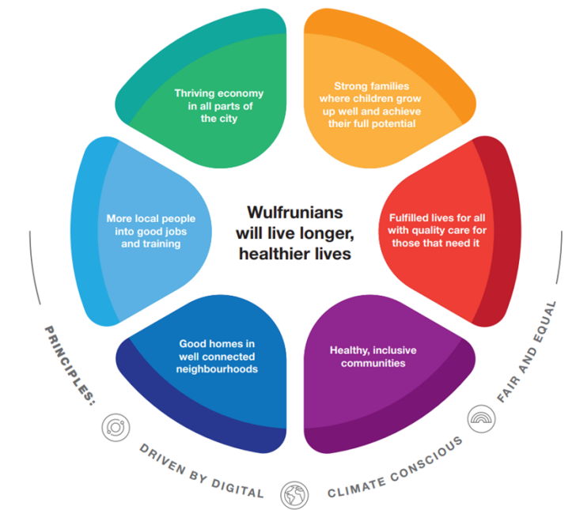
Our City: Our Plan
Task
Wolverhampton City Council aim to expand the city and build the skills needed for the future through the following framework. They hope to achieve this by 2030.
Categorise your solutions from the previous slide into a petal on this framework. Where is the most investment needed?
Extension
Is there a 7th petal needed? What would you call it?
Notes:
TEACHER NOTES & IDEAS
Taken from page 6 of: https://consultation.wolverhampton.gov.uk/cwc/education-skills-and-employment-strategy/user_uploads/strategy-document-draft-education-skills-and-employment-2023.pdf

Slide 12



Wolverhampton LMI Statistics
0
Finance
A
4, 500
Construction
B
3, 000
Education
C
11, 000
Mining & Quarrying
D
Task: Match the number of people working in each sector in Wolverhampton
What do these numbers tell you about the population of the area?
Notes:
TEACHER NOTES & IDEAS
Taken from: https://www.nomisweb.co.uk/reports/lmp/la/1946157192/report.aspx?town=wolverhampton#tabjobs
Total number of employed people is 106, 000

Slide 13




Task
Choosing one of the skills which is facing a skills gap, you have been asked to design a skills workshop for Year 7s. It can last from 1 lesson - a whole school day.
Be sure to include activities which:
explain what the skill is
give attendees an opportunity to practice and use the skill
explain the relevance of the skill to the workplace
Fun, interactive activities
Variety of individual, pair and group tasks
Information on what the skill is
Examples of how the skill can be built at school
Links between the skill and the workplace
Extension
Include a real job which would need this skill
10 Minutes
Notes:
TEACHER NOTES & IDEAS

