Slide 1


Friday, 15 May 2026
UCAS vs. Apprenticeships vs. Employment
LO: To know about UCAS, apprenticeships or employment for post-18 routes - which one and the process involved.
Year 13
What do you think or need that leads to:
The highest level of income?
The best job security?
Your perfect career?
© 2020
Living in the Wider World: Careers

Slide 2
Friday, 15 May 2026
UCAS vs. Apprenticeships vs. Employment
LO: To know about UCAS, apprenticeships or employment for post-18 routes - which one and the process involved.
Hard: Identify the options available for post-18 routes.
Harder: Describe the processes involved.
Hardest: Evaluate the options available from a personal perspective.
Skills and Personal Development:
Knowledge and understanding of the various available options.
Time management to adhere to the different deadlines for a successful application.
An awareness of planning for a smooth transition.
Use of labour market information to inform planning.
Living in the Wider World: Careers
Year 12 Healthy and Wellbeing: Mental Health issues in Contemporary Society and Resilience

Slide 3
Based upon an IBIS World research, in 2019-20, what were the top 10 fastest revenue growing industries in the UK?
Open-Ended Investment Activities (179.4%)
Life Insurance (98.5%)
Customer Relationship Management (CRM) Providers (43.15%)
Language Learning Software Developers (41.3%)
Online Greeting Cards Retailers in UK (34.5%)
Healthcare Construction (26.3%)
Online Food Ordering and Delivery Platforms (26.2%)
Audiobook Publishing (25.0%)
Immersive Technology, e.g. virtual reality (22.8%)
Juice, Mineral, Water & Soft Drink (22.2%)
Source: https://www.ibisworld.com/united-kingdom/industry-trends/fastest-growing-industries/
Living in the Wider World: Careers

Slide 4
A KPMG report predicts which nine industries will increase output (production) in a post-Covid 19 UK during 2021 based upon 2019 levels?
Scientific Research & Development
Postal services
Veterinary
Retail
IT Communications
Telecoms
Vehicle Sales & Servicing
Pharmaceuticals
Water Utilities
Source: https://assets.kpmg/content/dam/kpmg/uk/pdf/2020/11/uk-economic-outlook-nov2020.pdf
Living in the Wider World: Careers

Slide 5

What is the Labour Market?
The Labour Market is simply the local job market! What kind of jobs are around you? What big companies are there? Are there any growing industries and are jobs well paid?
What is Labour Market Information?
Labour Market Information helps to break down the ‘world of work’- ranging from descriptions of different careers, their entry routes, promotional prospects, salaries paid, skills and qualifications needed, etc
Labour Market Information also covers future demand- what kinds of jobs will be in demand after leaving school and what kinds of skills will be needed.

Slide 6
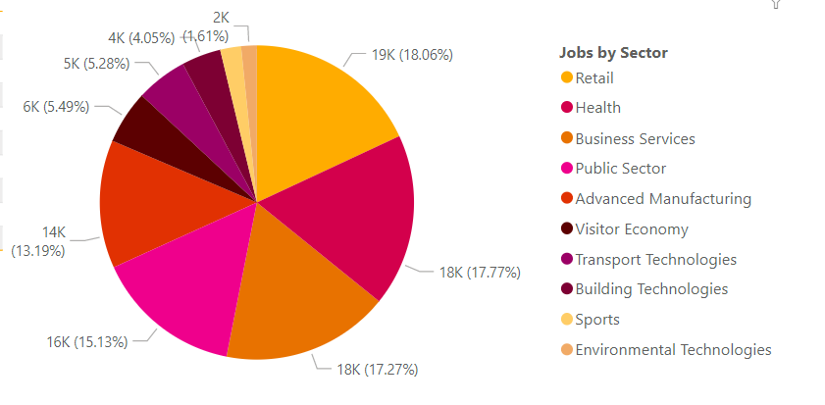
LMI For The Black Country

Slide 7

But how do we get to the world of work?
What are the options?
Living in the Wider World: Careers

Slide 8

University Colleges Admission Service
What is UCAS?
Living in the Wider World: Careers
Notes:
Click through and Play clip: What is UCAS? | learndirect

Slide 9

University Colleges Admission Service
How to Choose a Course?
Living in the Wider World: Careers
Notes:
Click through and Play clip: How to choose the right university course

Slide 10

University Colleges Admission Service
How to Apply?
Living in the Wider World: Careers
Notes:
Click through and Play clip: How To Apply To University | UCAS Application Process

Slide 11
University Colleges Admission Service – Key Points & Dates
Course or University | National Deadline
Oxford and Cambridge | 15th October
Medicine, Dentistry or Veterinary Sciences | 15th October
Other courses | 15th January
Art | Institutions may specify a different date (possibly in March) check with each organisation and UCAS
Set an Your Own Internal Deadline! This means:
Personal statement and application are completed for…
  Review and suggest any final revisions YOU should make
  Arrange an appointment for final checking and sending
Personal Statements require many drafts and redrafts
  Seek advice from your
    Tutor and class teachers
    Head of year
    Careers leader
National Deadline:
  Everyone’s (all applicant’s) deadline
  Avoid IT crashes by submitting before the deadline
  Your application must be considered
  Submission after the deadline means the university decides whether to consider it.
Living in the Wider World: Careers

Slide 12
Don’t worry!
All of this info will be provided to you again in future, so don't worry if you didn't make note of any dates.
The school will help to walk you through the UCAS process in Sixth Form.
Living in the Wider World: Careers

Slide 13

Degree Apprenticeships
Living in the Wider World: Careers
Notes:
Play video: https://youtu.be/zBvmHbl_4FY

Slide 14

A Day in the Life of an Apprentice
Living in the Wider World: Careers
Notes:
Play video: https://youtu.be/zBvmHbl_4FY

Slide 15


Degree Apprenticeships
Combine full time work with part time university study (3-6 years).
Same expectations as any other employee! A career with high level training.
No tuition fees! Government and employer funded.
Min 30 hours per week for 30 weeks @ employer for a paid salary.
Living in the Wider World: Careers

Slide 16

Degree Apprenticeship Applications
Find opportunities by
  UCAS (official)
  https://www.gov.uk/apply-apprenticeship (official)
  https://www.ratemyapprenticeship.co.uk/ (advice)
  Many other sites
When to apply
  Just like any employment opportunity
    When they are advertised throughout the year
How to apply
  Through the employer’s website or their own process – it could be (some, all or different methods)…
    Application form
    Interview – telephone, video call, face-to-face, panel, multiple times
    Tests or exams
    Presentation
    In-tray exercises
    Assessment days
Living in the Wider World: Careers

Slide 17

University or Degree Apprenticeship?
Living in the Wider World: Careers
Notes:
Play Video: https://youtu.be/tDnb9wWhPqE

Slide 18
Employment – Points to Consider
What are your goals and aspirations?
Are you using it as a gap year to decide your future?
Are you considering self-employment (running your own business)
  High risk without industry specific skills, experience and training
  Would it be better to gain these through formal training/apprenticeship first?
Will this job help me to maximise lifetime time or achieve my goals?
Where will you be and what will you be doing in 5- or 10-year's time?
  If it is the same as day 1 of your employment or similar, do you think it would have been a good choice?
Does the job have prospects?
  Is there a personal development/training programme?
  Is it a job without this? Aka a deadend job, i.e…..
Is this choice a good investment for your own future?
If there are personal challenges that pursade you to deselecting the other options see the careers leader, head of year or your tutor for guidance.
Living in the Wider World: Careers
Notes:
Click through to show the 7 points.

Slide 19
Employment – pros and cons
Short Term Gains
Relatively good income vs now or compared to current spending
Have the cash to attempt to impress in your purchases and going out
Less pressure and more time to focus on leisure or whatever…
Living in the Wider World: Careers
Notes:
Click through for each point

Slide 20
Employment – pros and cons
Long-term or Opportunity Costs
Personal development
  An apprenticeship represents a company’s long-term investment in you. You are part of their future.
  A degree is an investment in yourself
Degrees or apprenticeships support transferable skills that all too many contexts.
  Would your job do the same?
Loss of a better lifetime income
  Those that have a degree or apprenticeship are earning and gaining more within a few years
Compromises due to a lower income, e.g.
  Rent when you prefer to own a property
  Cheaper holidays and leisure activities
  Your children and or partner can’t do X, Y or Z
  A lower pension pot even if you can afford one.
Your ability to deal with adverse events is more challenging
Greater risk of redundancy because you are cheaper than others to do this to.
Living in the Wider World: Careers
Notes:
Click through for each point

Slide 21
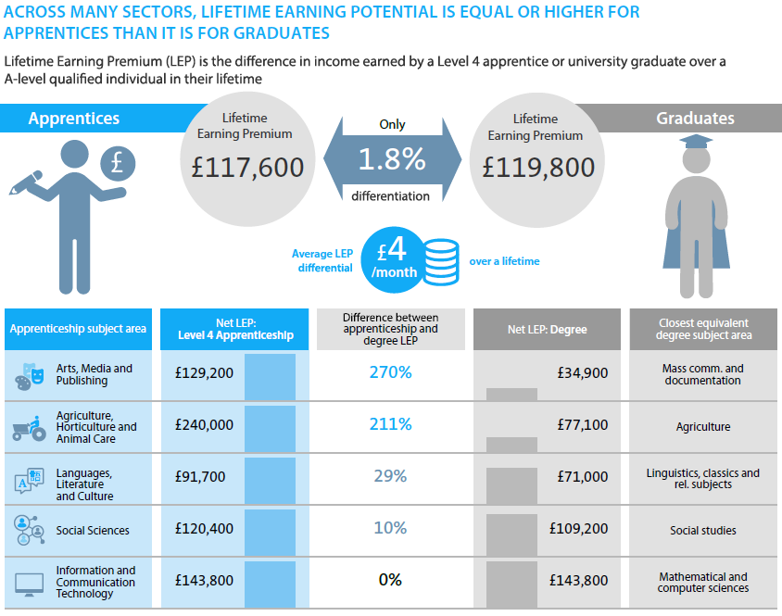
University or Apprenticeship or Employment?
Lifetime Earning Premium above those that entered employment at the end of Year 13.
Those with an apprenticeship or degree earn more over a working life.
Level 4 (Higher/first year university only) Apprenticeship can lead to greater earnings over degree students – subject area dependent
Study by Barclays and Centre for Economics and Business Research, 2016
Notes:
Study source: https://www.cedefop.europa.eu/en/news-and-press/news/united-kingdom-lifetime-earnings-apprentices-gaining-graduates

Slide 22

Friday, 15 May 2026
UCAS vs. Apprenticeships vs. Employment
LO: To know about UCAS, apprenticeships or employment for post-18 routes - which one and the process involved.
What will you take away from today’s lesson?
Write a personal pro’s and con’s list that includes each option with the economic conditions.
What’s your conclusion?
Is more information needed?
HARD: I know how to Identify options available for post-18 routes .
HARDER: I can describe the processes involved.
HARDEST: I can consider and evaluate the options available from a personal perspective.
© 2020
Living in the Wider World: Careers

